Slide 1
Does Double-Blind Review Reduce Prestige Bias?
SI 699 Final Presentation
By: Jainabou barry danfa
April 16th, 2020

Slide 2
What and Why
Peer Review is important to academic research and advancement.
Many journals have switched from single-blind to double-blind but a study on its effects on prestige bias have not been studied upon. [which one is better?]
The work that gets accepted matters in terms of funding, recognition, and advancement in fields
Single-Blind
Authors do not know the identity of reviewers
Reviewers knows the identity of authors
Double-Blind
Authors do not know the identity of reviewers
Reviewers do not know the identity of authors

Slide 3
ICLR Peer Review Process
International Conference on Learning Representations Conference: Founded in 2013 focuses on Deep Learning and AI
Paper Submission
Authors submit paper on public forum
Identities will be concealed if double-blind
Reviewer Bidding
Reviewers bid for papers to review
Author Discussion / Rebuttal Period
Reviewers post full review on public forum
Authors can address reviewers comments and modify papers during specified period
Each paper gets assigned 3 reviewers
Affinity scores are used o help with paper bidding and avoid conflict or interest
Final Decision
Area Chairs and reviewers make final decision on papers acceptance or rejection

Slide 4
Analysis Process
Microsoft Academic Author Query
Search citation and publication counts for each author 5 years prior to the paper submission
Microsoft Academic Paper Query
Search using paper title to find all author ids
OpenReview ICLR Query
Obtain all submissions and review information for 2017-2020
Data Gathering
Data Processing
Model Development
Aggregate the citation and publication counts for each paper
Use VADER to get sentiment scores for the reviews
Rank author affiliations by accepted papers ranking
Logistic Regression using features for acceptance prediction

Slide 5
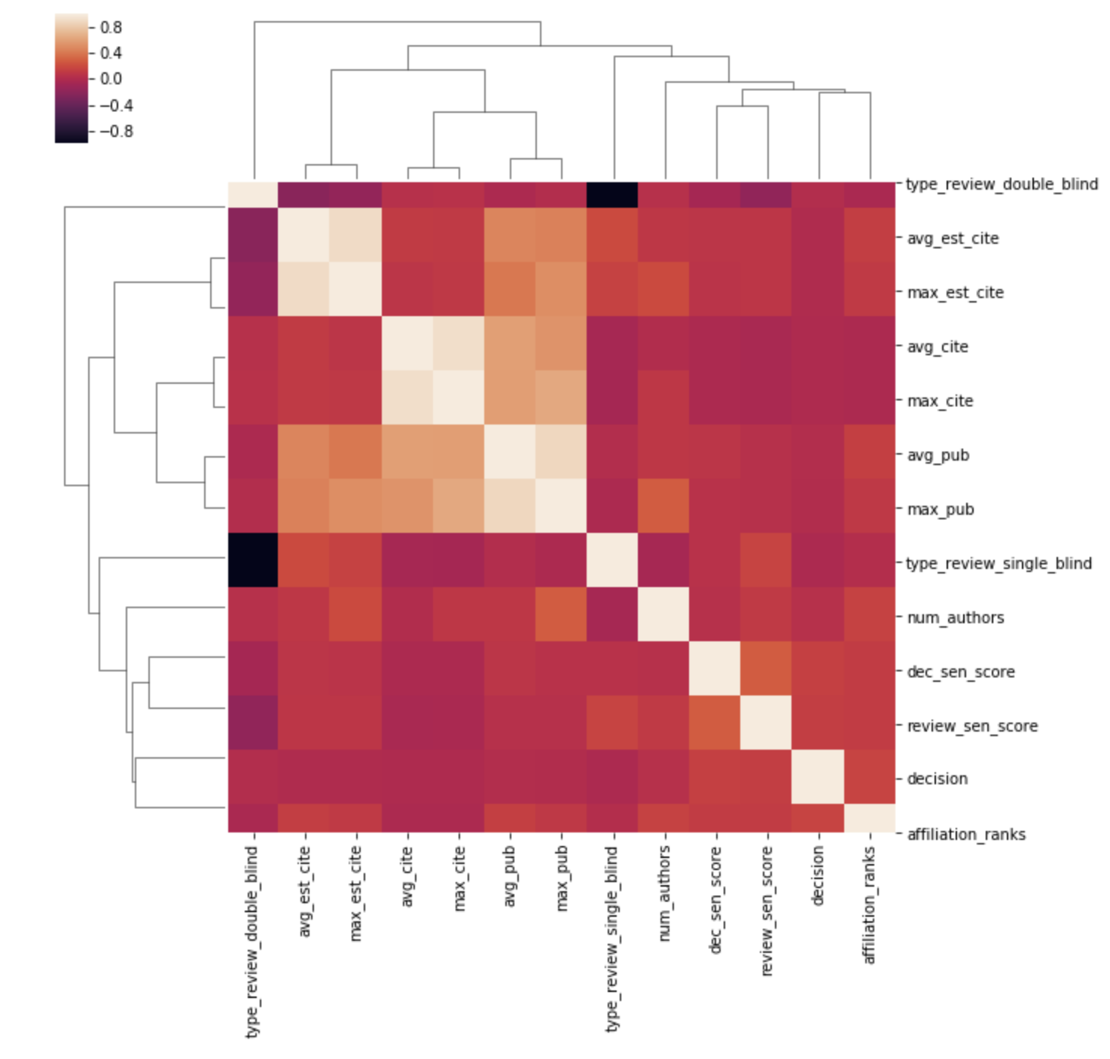
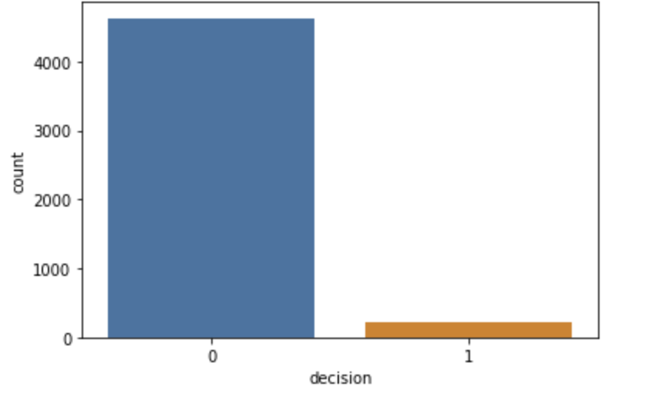
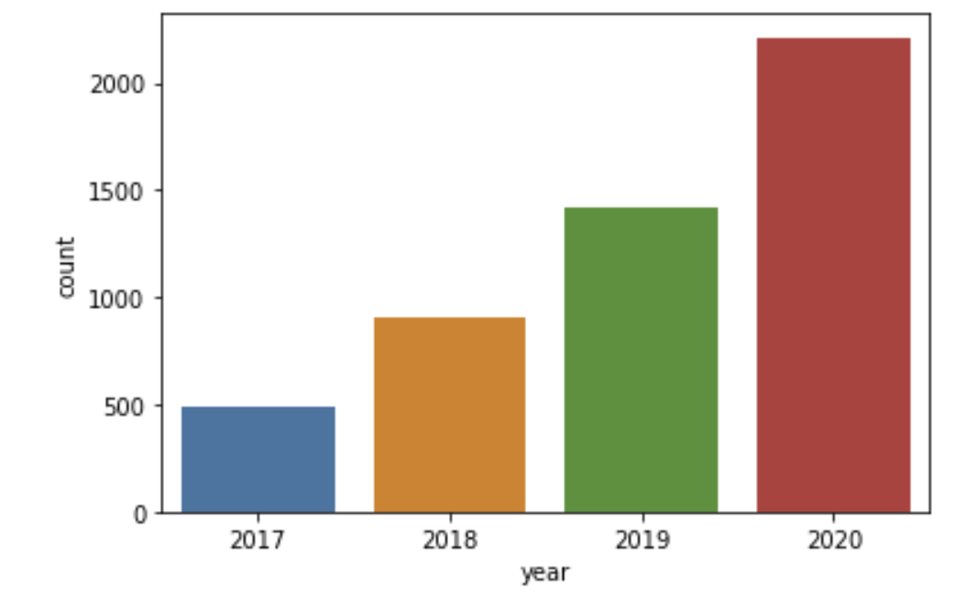
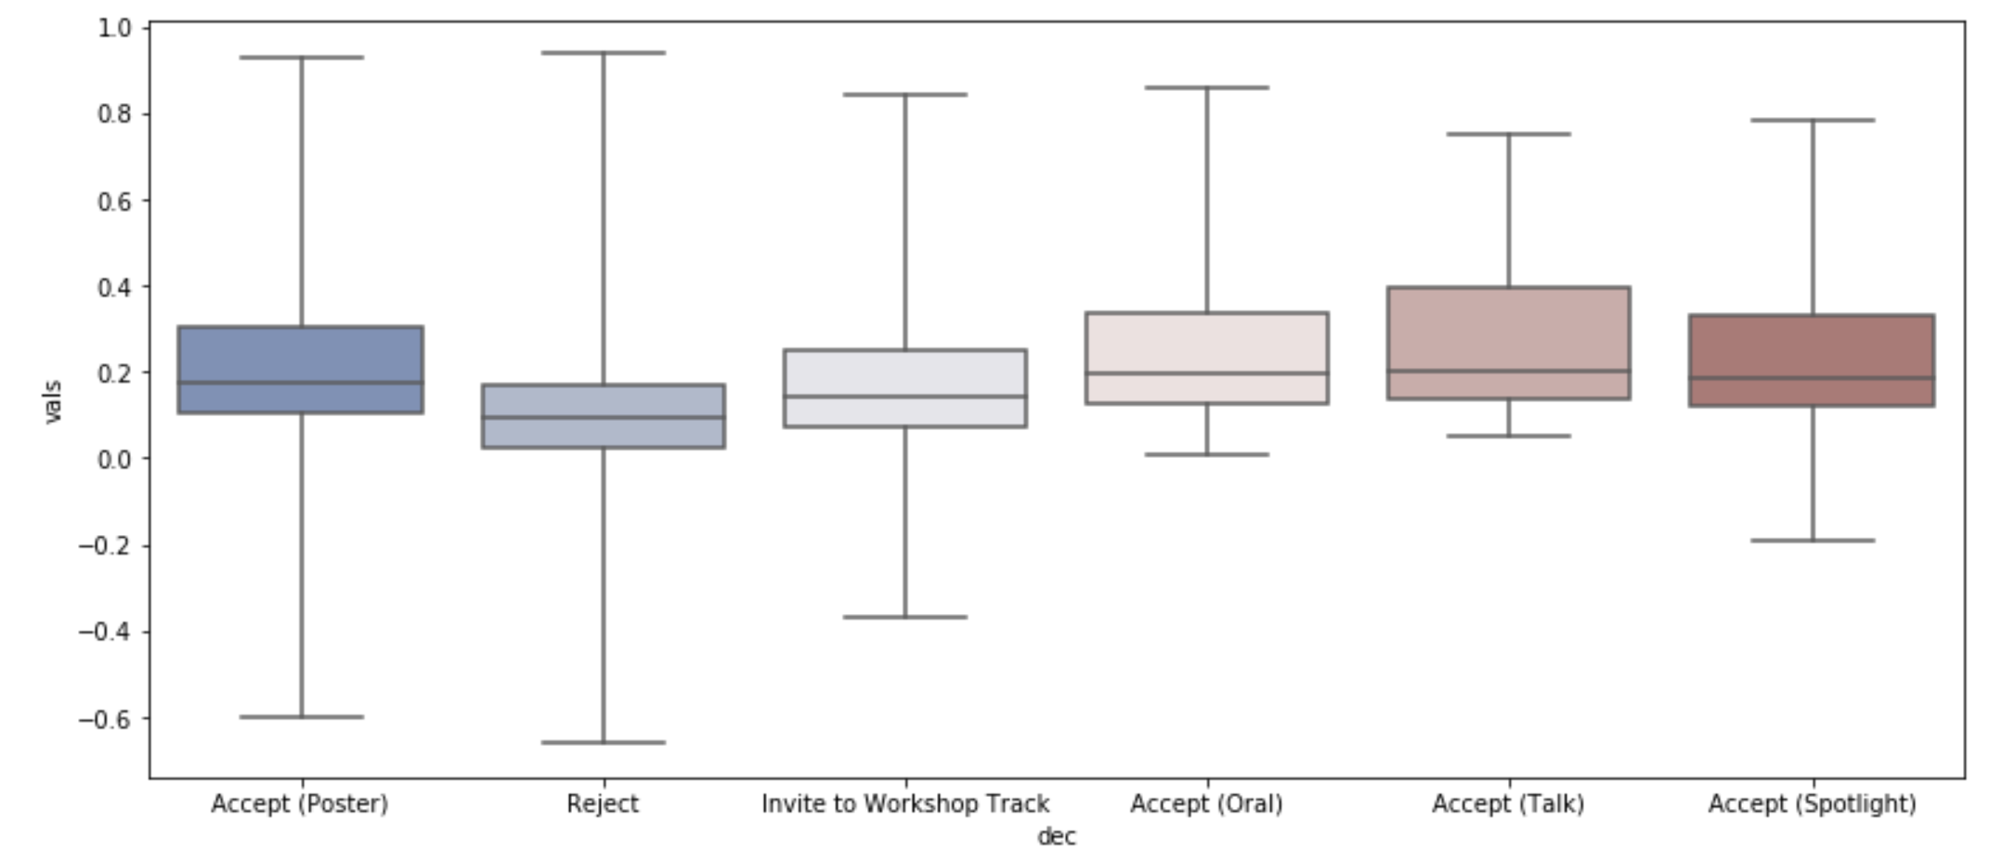
Exploratory Data Analysis
5033 paper submissions over all years
4842 papers matched from query
No strong correlations based on type of review
Sentiment scores do not differ a lot based on decision and type of review
Reject={poster, workshop, official reject}
Accept={oral, talk, spotlight}

Slide 6
Model Performance

Slide 7
Model Performance

Slide 8
Implications/ Further Questions
Does the type of review really not matter for acceptance based on prestige?!
Multi-class prediction for different types of submission decisions
Get different metrics for prestige to ensure not measuring popularity (look into network interactions)
Validate with other conferences
Does institution prestige impact bidding with single-blind and double-blind?
With the rise of papers posted before acceptance into journals, is double-blind actually double-blind?

Slide 9


Slide 10
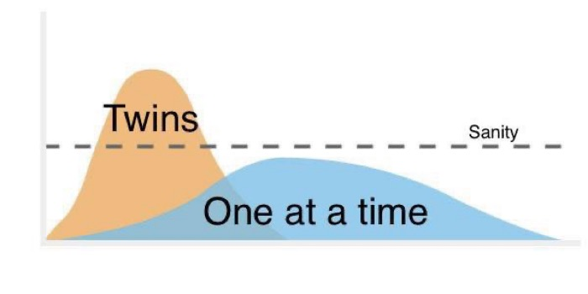
Data Collection
Data Management
Analysis
MAG had 3 different sources to get data and spent A LOT of time finding the right solution, many dead-ends
OpenReview documentation was not thorough, spent A LOT of time on github looking at source code and piecing things together
Managing multiple data sources and with various unique identifiers became confusing
Not confident in the analysis because did not match expected behavior
Workload Management
Working alone did not give much space for discussion about other approaches [thanks Misha!]
“Flattening the Curve”
Allow Ample Time for Data Collection
Think of retrieval methods when storing data
Trust the Data

Slide 11
Questions?

